Slide 1
Guide to Spring RestTemplate

Slide 2

What is Spring RestTemplate? Some Useful Methods of RestTemplate Project Setup for Running the Demos
Overview
Making an HTTP GET Request to Obtain the JSON Response Making an HTTP GET Request to Obtain the Response as a POJO Making an HTTP POST Request Using exchange() for POST Using exchange() for PUT with an Empty Response Body Using execute() for Downloading Large Files Invoking APIs with application/form Type Input Configuring the HTTP Client in RestTemplate Attaching an ErrorHandler to RestTemplate Attaching MessageConverters to the RestTemplate Comparison with Other HTTP Clients

Slide 3
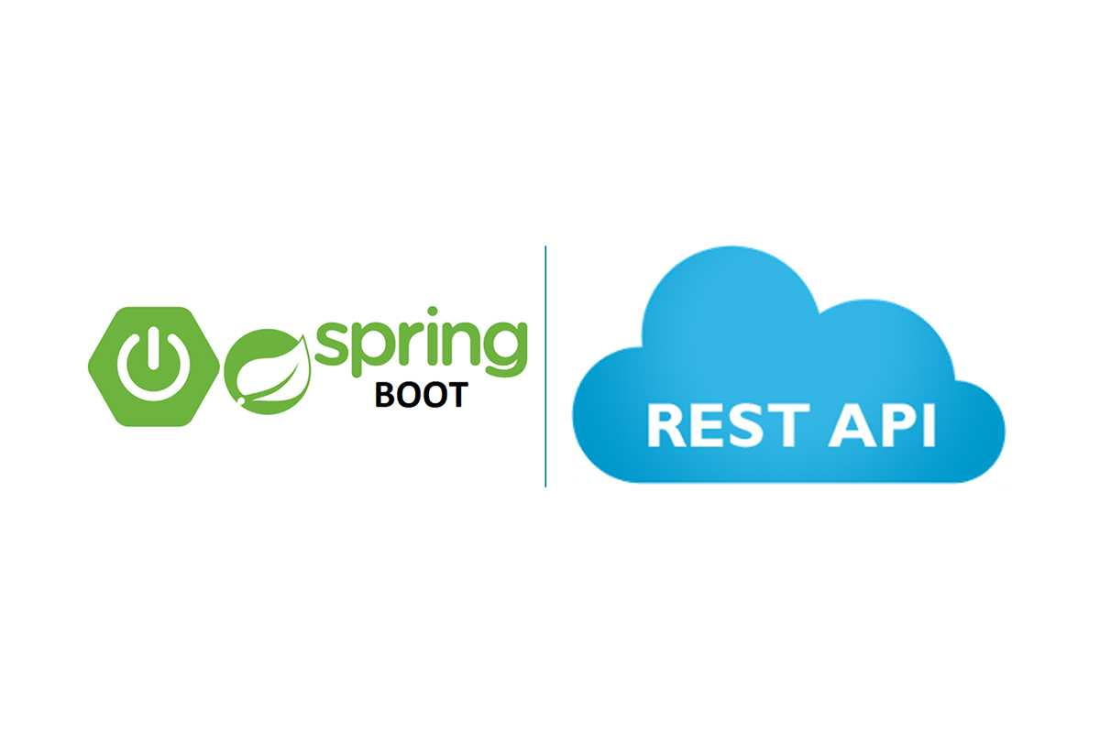
What is RestTemplate?
RestTemplate is Spring’s central class for synchronous client-side HTTP access.
The class supports a wide variety of methods for each HTTP method that makes it easy to consume RESTful services.
The class is a part of the spring-web which was first introduced in Spring 3.

Slide 4
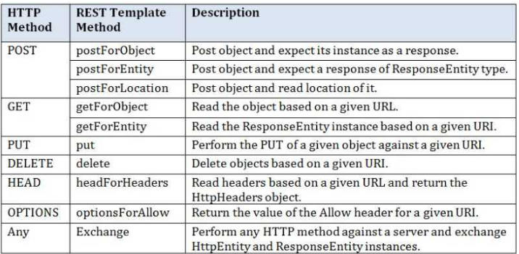
Rest Template Methods

Slide 5
RestTemplate is a synchronous client for making REST API calls over HTTP. RestTemplate has generalized methods like execute() and exchange() which take the HTTP method as a parameter.
Summary
Separate methods for making different HTTP calls like getForObject() and getForEntity(). Option of getting the response body in raw JSON format which needs to be further processed with a JSON parser or a structured POJO that can be directly used in the application.
Request body is sent by wrapping the POJOs in a HttpEntity class.
Customize with an HTTP client library, error handler, and message converter.
Calling RestTemplate methods results in blocking the request thread till the response is received.

